Slide 1
Algorithms at Scale
CS 5234
Lecture 1

Slide 2
About This Course
This is an algorithms course.
Given a problem, design an algorithm.
Prove the correctness of the algorithm.
Sometimes we only argue that the algorithm usually works.
Analyze the algorithm’s time complexity.
Sometimes we also care about space complexity.

Slide 3
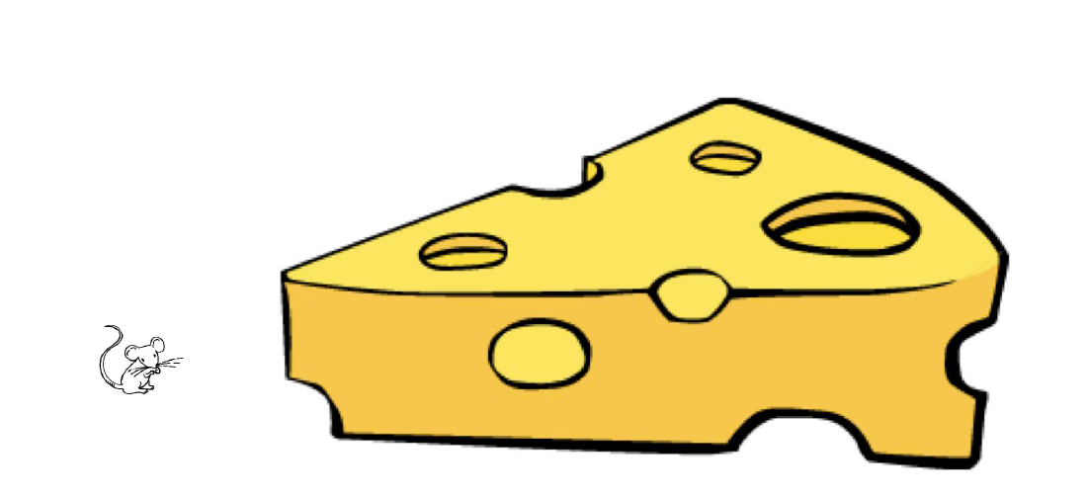
What Does ‘Algorithms at Scale’ Mean?
Too much input. Too few resources.
Time and space.

Slide 4

Time
The input is so large that we cannot afford to read it in full.
We only read a small part of the input.
How many foreign residents are there in Singapore?

Slide 5

Limited Time: Query Algorithm
We don’t have the time to read the entire input.
We read a small part of the data.
Output a statistic of the data
E.g., Number of one type of element.
The algorithm accesses a small amount of input.
Output based on the limited information we learn.

Slide 6
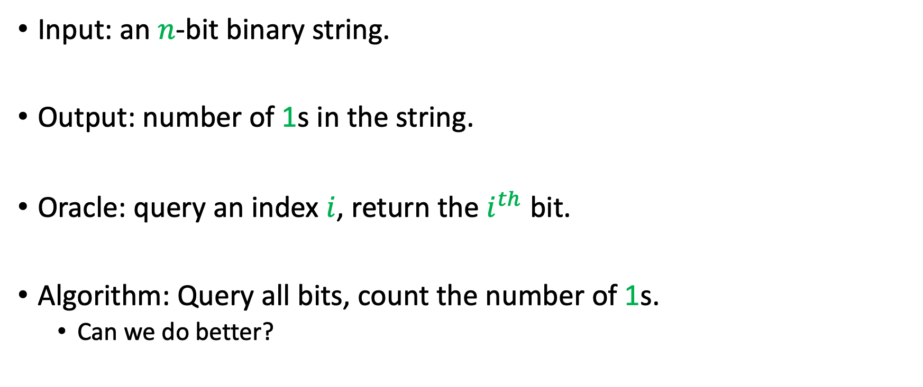
Example
Input: an $n$-bit binary string.
Output: number of 1s in the string.
Oracle: query an index $i$, return the $i^{th}$ bit.
Algorithm: Query all bits, count the number of 1s.
Can we do better?

Slide 7
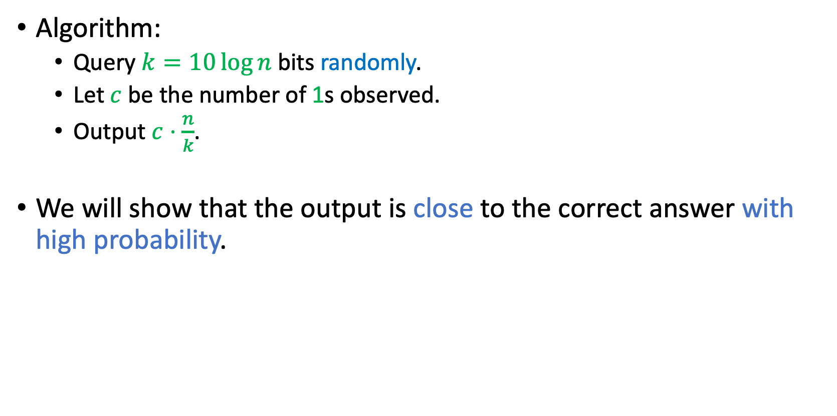
Another Algorithm
Algorithm:
Query $k=10\log{n}$ bits randomly.
Let $c$ be the number of 1s observed.
Output $c⋅\frac{n}{k}$.
We will show that the output is close to the correct answer with high probability.

Slide 8
Space
The input is so large that it cannot be stored in our computer.
The input continues to come to us, but we can only retain a limited amount of information.
How many foreign residents are there in Singapore?

Slide 9
Space
The input is so large that it cannot be stored in our computer.
The input continues to come to us, but we can only retain a limited amount of information.
How many different countries are represented among foreign residents in Singapore?

Slide 10
Limited Space: Streaming Algorithm
Observe a long stream of data,
Output a statistic of the data
E.g. Number of distinct elements
Input arrives in a stream and the algorithm has limited space.
Output based on the limited information we stored.

Slide 11
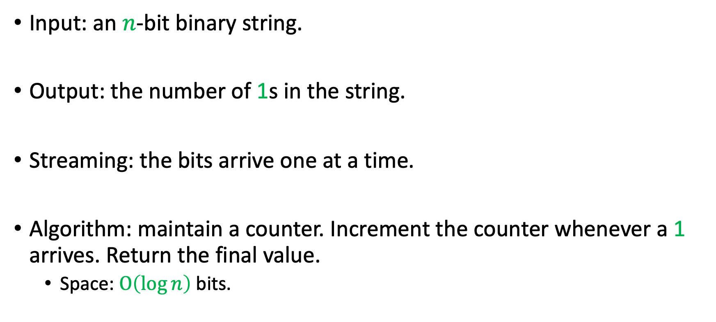
Example
Input: an $n$-bit binary string.
Output: the number of 1s in the string.
Streaming: the bits arrive one at a time.
Algorithm: maintain a counter. Increment the counter whenever a 1 arrives. Return the final value.
Space: $O\left(\log{n}\right)$ bits.

Slide 12
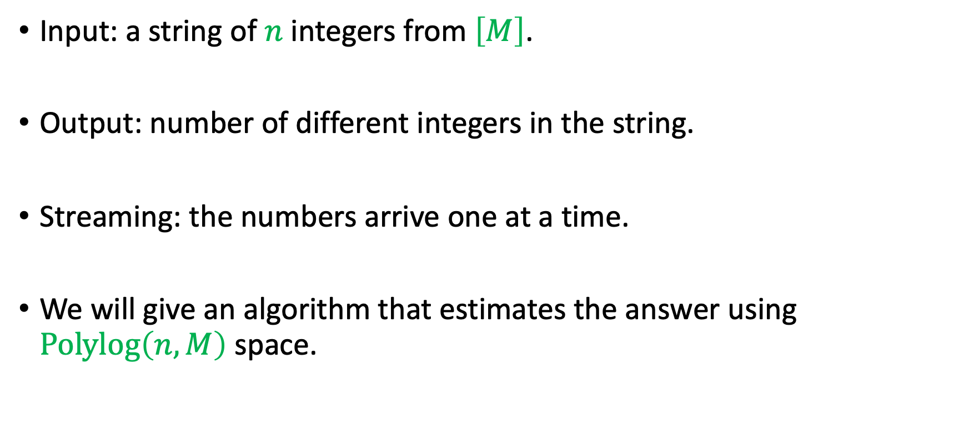
Another Example
Input: a string of $n$ integers from $\left[M\right]$.
Output: number of different integers in the string.
Streaming: the numbers arrive one at a time.
We will give an algorithm that estimates the answer using $Polylog\left(n,M\right)$ space.

Slide 13
Other Resources
The input is large, but we have a lot of computers.
CS 4231
Every computer can access the input.
Limited adaptivity
Every computer stores a part of the input.
Limited communication

Slide 14
Course Objectives
Algorithms using a small amount of resources (time/space).
Tools and techniques to design these algorithms.
How to prove that they work.
Problems that cannot be solved with a small amount of resources.
What kind of problems are hard?
How to prove that these problems are hard.
General techniques for designing and analyzing algorithms with randomization and approximation.

Slide 15
Lectures
2 hours of lecture every week
Thursday (6:30 pm – 8:30 pm), at LT12
1 hour of tutorial occasionally
Essentially an extra hour if I cannot finish;
Sometimes talk about exercise problems.
Contact: yu.chen@nus.edu.sg
Office Hours: Wednesday 17:00, COM 2-2-58
Email me on Tuesday if you intend to come.
TA Office Hours: TBD

Slide 16
Assessment (100% CA)
Quiz: 40pts
Two quizzes, each 20pts, 50 mins.
Week 7, Week 12.
Assignments: 30pts
3 Assignments: 15pts each.
Late penalty: 2pts per day.
Assignment score = min{30,sum}.
Please use LaTeX/Markdown/Word.
Project: 30pts

Slide 17
Project
Write a survey on one topic.
Work in groups of up to four.
You may find topics on sublinear.info.
You can also choose your own topic related to the course.
About 10 pages.
Introduction.
Summary of known results.
Describe one result in detail.
Try to use your own words.
Future Directions.
What direction do you want to try?

Slide 18
Project Timeline
Week 7: Form your group and select the topic.
Week 10: Select the paper.
Week 13: Finish the survey.

Slide 19
Academic Policy (on Plagiarism)
You may discuss general approaches with classmates, but not detailed solutions.
Write your own solutions and acknowledge all collaborators.
Do not copy or compare solutions, or post assignment questions or solutions publicly.
Ask course-related questions on Canvas.
You may use AI tools to brainstorm, but the final reasoning and write-up must be your own.
Violations will be handled according to the School’s academic integrity policy.

Slide 20
Any Questions?

Slide 21
Probability and Concentration

Slide 22

Probability
Given an event $A$, $\operatorname{Pr}\left(A\right)$ is the probability that $A$ occurs.

Slide 23
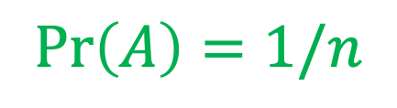

Probability
What is the probability that the ball is in bin #2?
$$A$$
$\operatorname{Pr}\left(A\right)=1/n$
1
2
3
n

Slide 24

Probability
Given an event $A$, $\operatorname{Pr}\left(A\right)$ is the probability that $A$ occurs.
Two events $A,B$ are independent if $\operatorname{Pr}\left(A,B\right)=\operatorname{Pr}\left(A\right)⋅\operatorname{Pr}\left(B\right)$.

Slide 25

Probability
The ball is in bin #2
The ball is in bin #5
$$A$$
$$B$$
$\operatorname{Pr}\left(A,B\right)=0$, they are not independent.
1
2
3
n

Slide 26
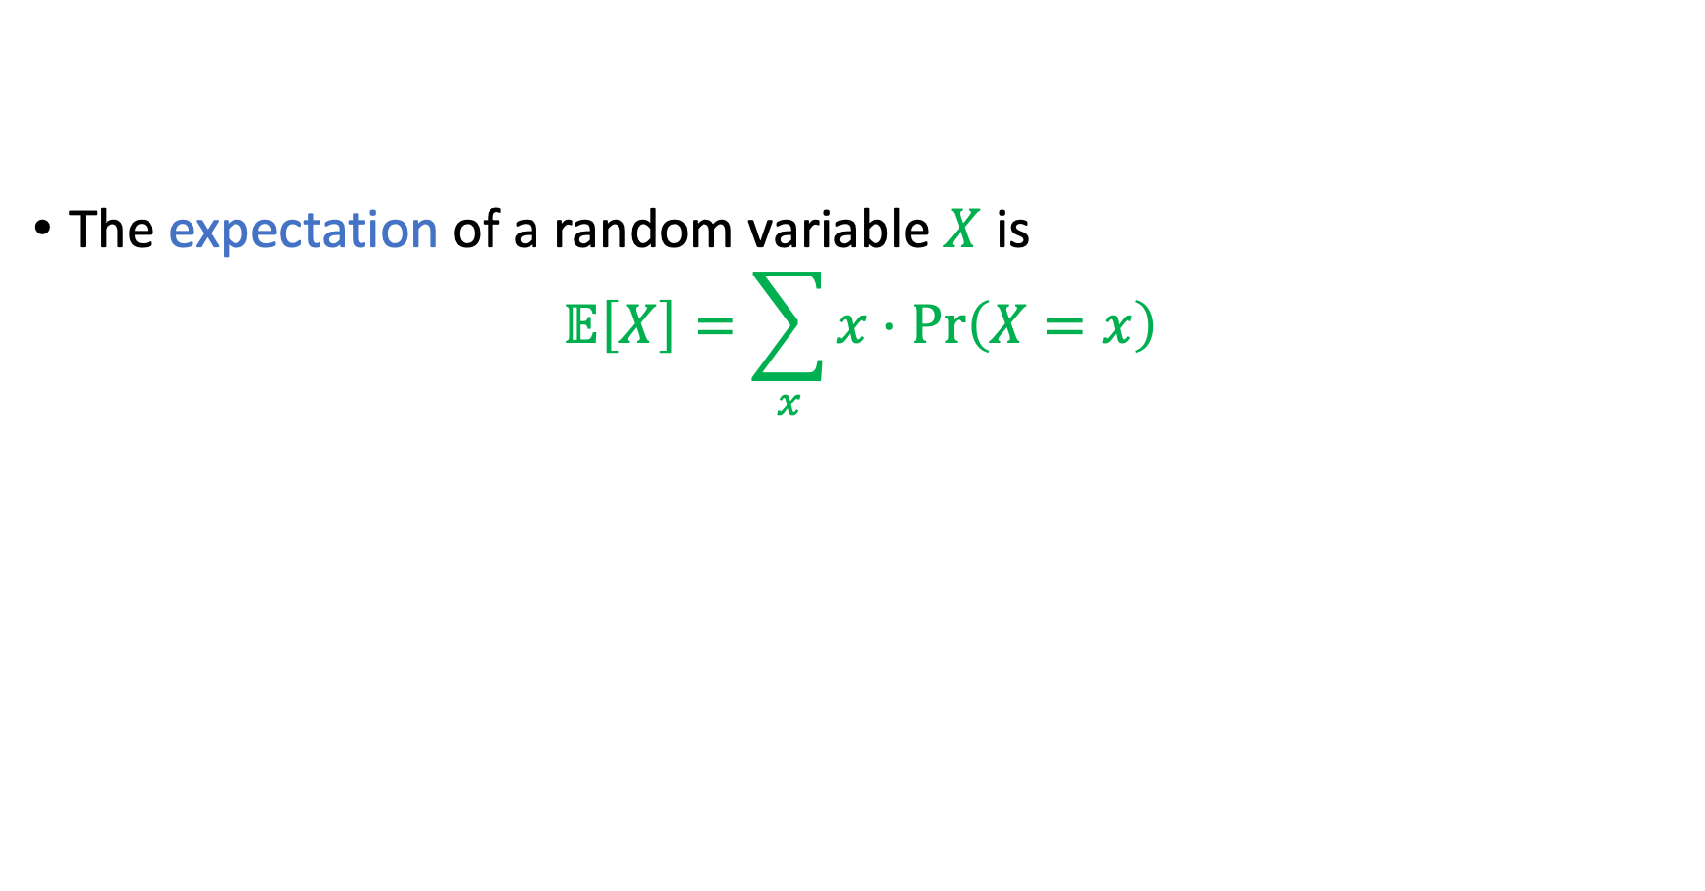
Expectation
The expectation of a random variable $X$ is
$$𝔼\left[X\right]=\sum_{x}{x⋅\operatorname{Pr}\left(X=x\right)}$$

Slide 27
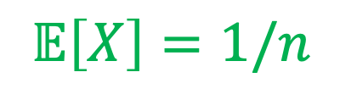

Expectation
What is the expected number of balls in bin #2?
$$𝔼\left[X\right]=1/n$$
$$X$$
1
2
3
n

Slide 28
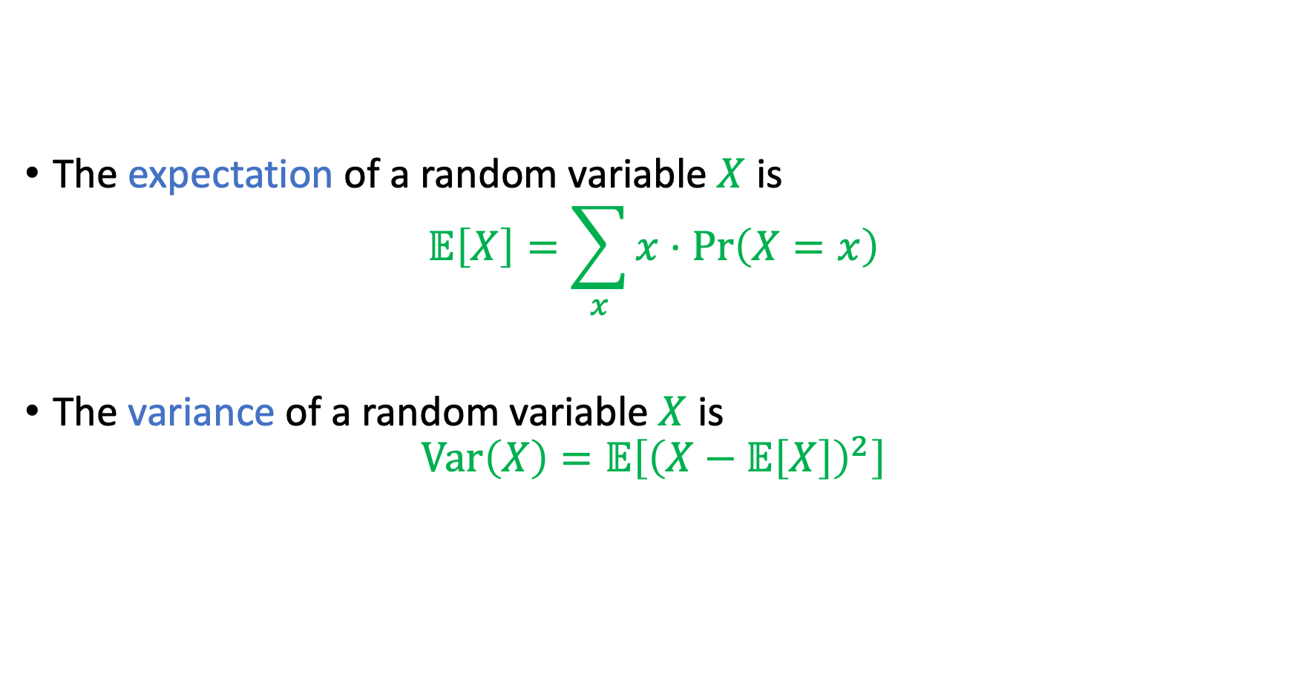
Variance
The expectation of a random variable $X$ is
$$𝔼\left[X\right]=\sum_{x}{x⋅\operatorname{Pr}\left(X=x\right)}$$
The variance of a random variable $X$ is
$$Var\left(X\right)=𝔼\left[{\left(X−𝔼\left[X\right]\right)}^{2}\right]$$

Slide 29
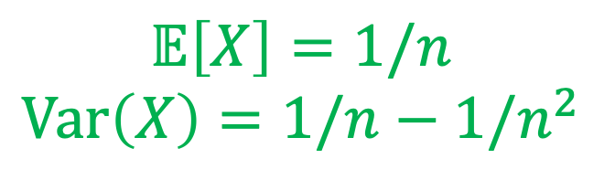

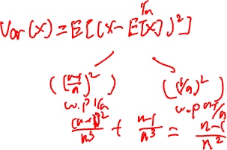
Expectation
What is the expected number of balls in bin #2?
$$𝔼\left[X\right]=1/n$$
$$Var\left(X\right)=1/n−1/n^{2}$$
$$X$$
1
2
3
n

Slide 30
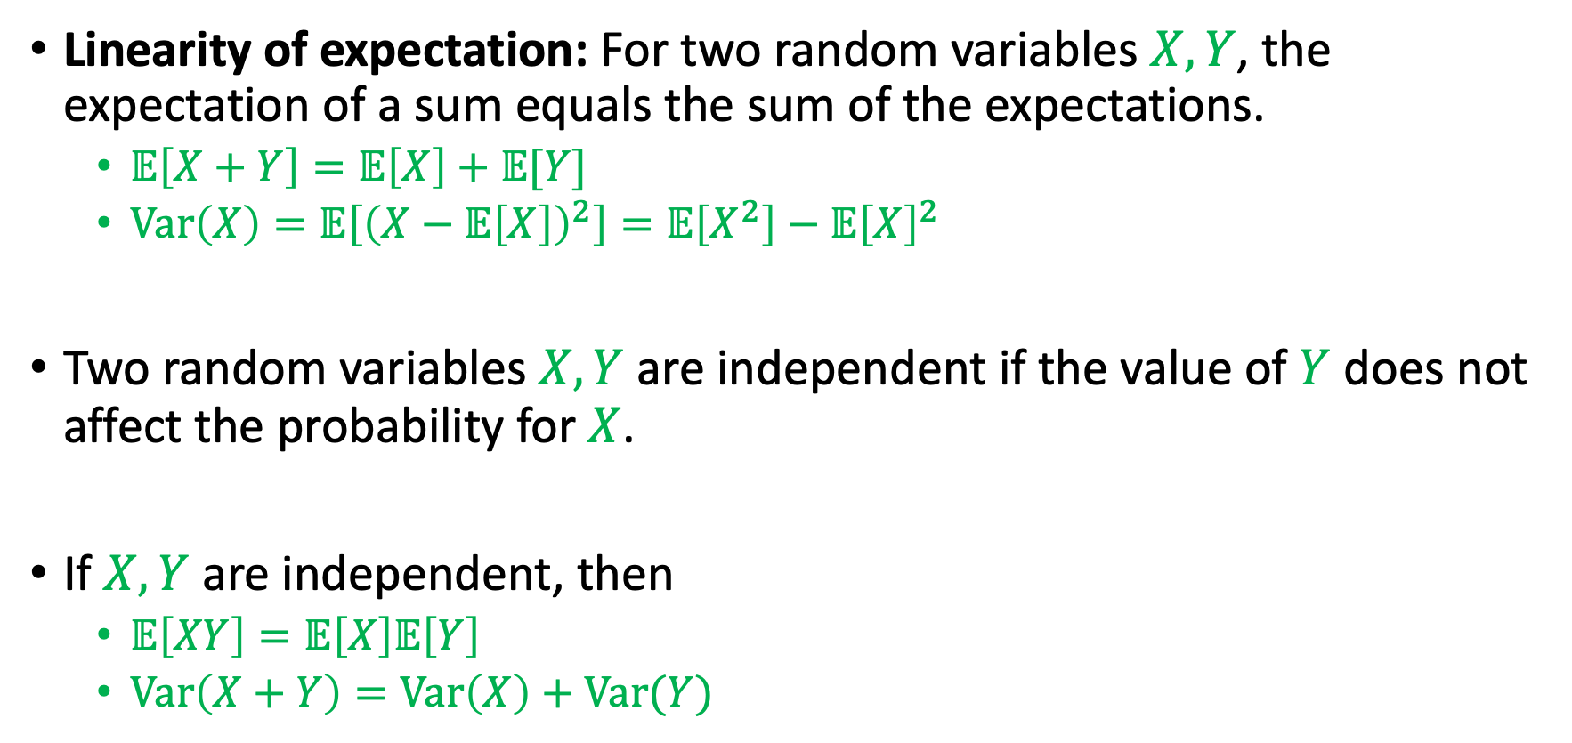
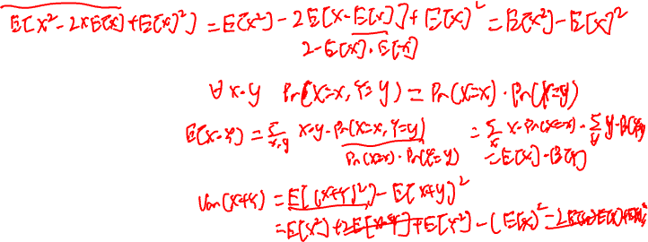
Random Variables
Linearity of expectation: For two random variables $X, Y$, the expectation of a sum equals the sum of the expectations.
$𝔼\left[X+Y\right]=𝔼\left[X\right]+𝔼[Y]$
$Var\left(X\right)=𝔼\left[{\left(X−𝔼\left[X\right]\right)}^{2}\right]=𝔼\left[X^{2}\right]−𝔼{\left[X\right]}^{2}$
Two random variables $X, Y$ are independent if the value of $Y$ does not affect the probability for $X$.
If $X, Y$ are independent, then
$𝔼\left[XY\right]=𝔼\left[X\right]𝔼\left[Y\right]$
$Var\left(X+Y\right)=Var\left(X\right)+Var(Y)$

Slide 31
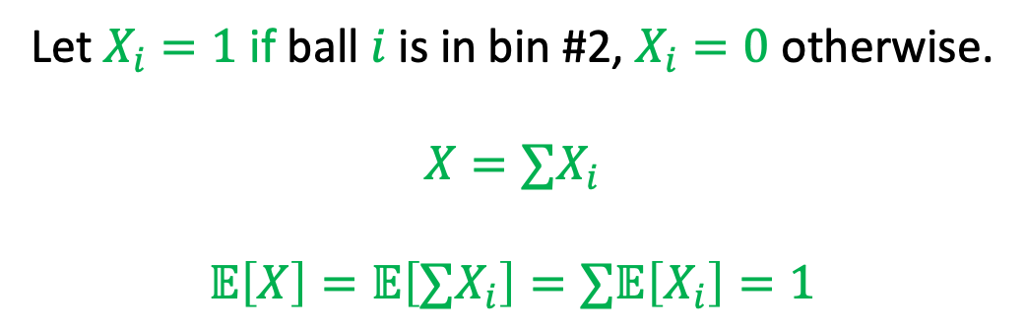
Expectation
n balls
Let $X_{i}=1$ if ball $i$ is in bin #2, $X_{i}=0$ otherwise.
$$X=∑X_{i}$$
$$𝔼\left[X\right]=𝔼\left[∑X_{i}\right]=∑𝔼\left[X_{i}\right]=1$$
What is the expected number of balls in bin #2?
$$X$$
1
2
3
n

Slide 32

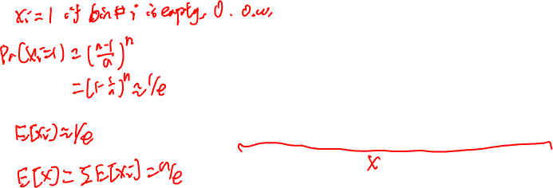
Exercise
Useful Inequality:
$${\left(1−\frac{1}{k}\right)}^{k}<\frac{1}{e}<{\left(1−\frac{1}{k}\right)}^{k−1}$$
In this course, we will just say
$${\left(1−\frac{1}{k}\right)}^{k}≈\frac{1}{e}$$
n balls
What is the expected number of empty bins?
1
2
3
n

Slide 33

Markov’s Inequality
For any non-negative random variable $X$ and any $α>1$, we have
$\operatorname{Pr}{(X>α𝔼}\left[X\right])≤1/α$
Proof: If $\operatorname{Pr}{(X>α𝔼}\left[X\right])>1/α$, then $𝔼\left[X\right]>\left(1/α\right)⋅α𝔼\left[X\right]=𝔼\left[X\right]$

Slide 34

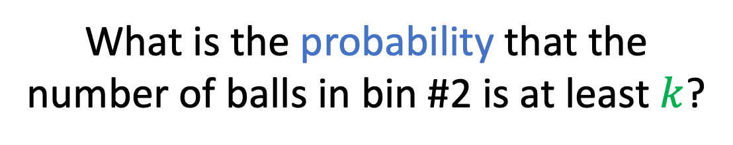

Expectation
n balls
What is the probability that the number of balls in bin #2 is at least $k$?
$$𝔼\left[X\right]=1$$
$$\operatorname{Pr}\left(X≥k\right)≤1/k$$
$$X$$
1
2
3
n

Slide 35
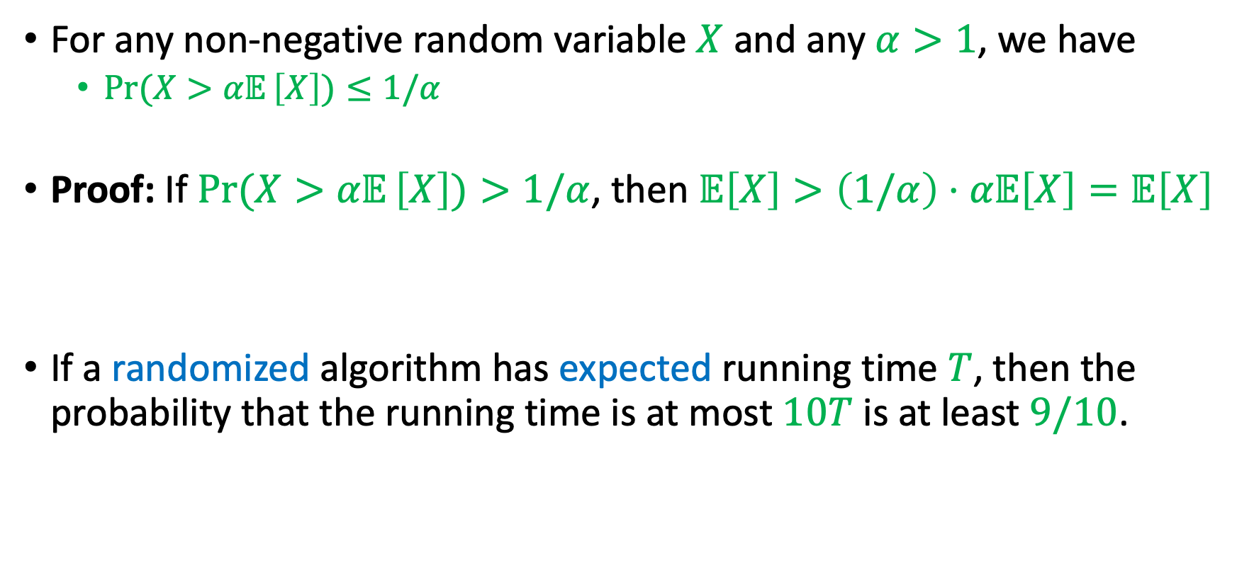
Markov’s Inequality
For any non-negative random variable $X$ and any $α>1$, we have
$\operatorname{Pr}{(X>α𝔼}\left[X\right])≤1/α$
Proof: If $\operatorname{Pr}{(X>α𝔼}\left[X\right])>1/α$, then $𝔼\left[X\right]>\left(1/α\right)⋅α𝔼\left[X\right]=𝔼\left[X\right]$
If a randomized algorithm has expected running time $T$, then the probability that the running time is at most $10T$ is at least $9/10$.

Slide 36
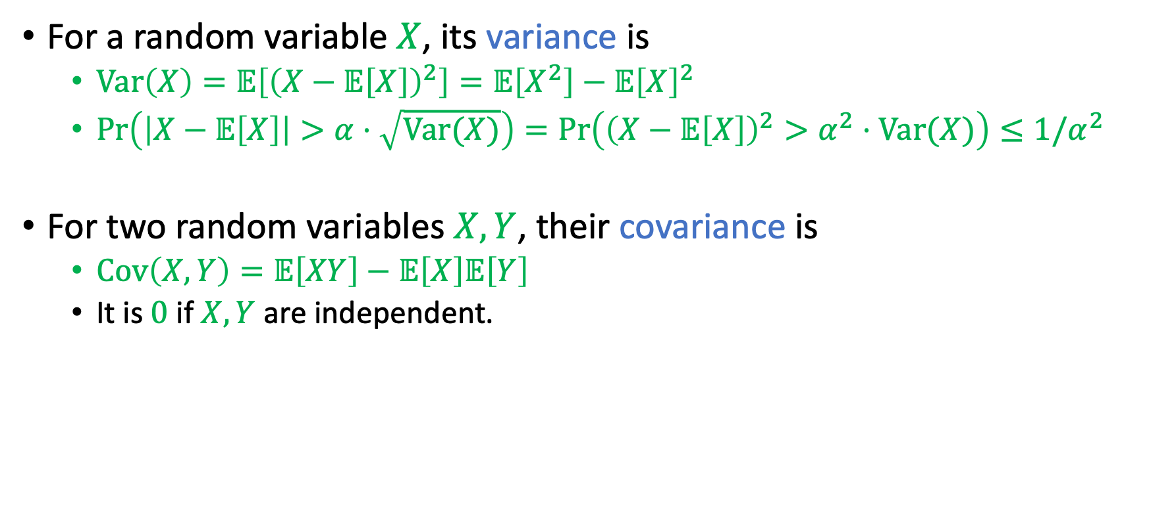
Chebyshev’s Inequality
For a random variable $X$, its variance is
$Var\left(X\right)=𝔼\left[{\left(X−𝔼\left[X\right]\right)}^{2}\right]=𝔼\left[X^{2}\right]−𝔼{\left[X\right]}^{2}$
$\operatorname{Pr}\left(\left|X−𝔼\left[X\right]\right|>α⋅\sqrt{Var(X)}\right)=\operatorname{Pr}\left({\left(X−𝔼\left[X\right]\right)}^{2}>α^{2}⋅Var(X)\right)≤1/α^{2}$
For two random variables $X,Y$, their covariance is
$Cov\left(X,Y\right)=𝔼\left[XY\right]−𝔼\left[X\right]𝔼\left[Y\right]$
It is $0$ if $X,Y$ are independent.

Slide 37
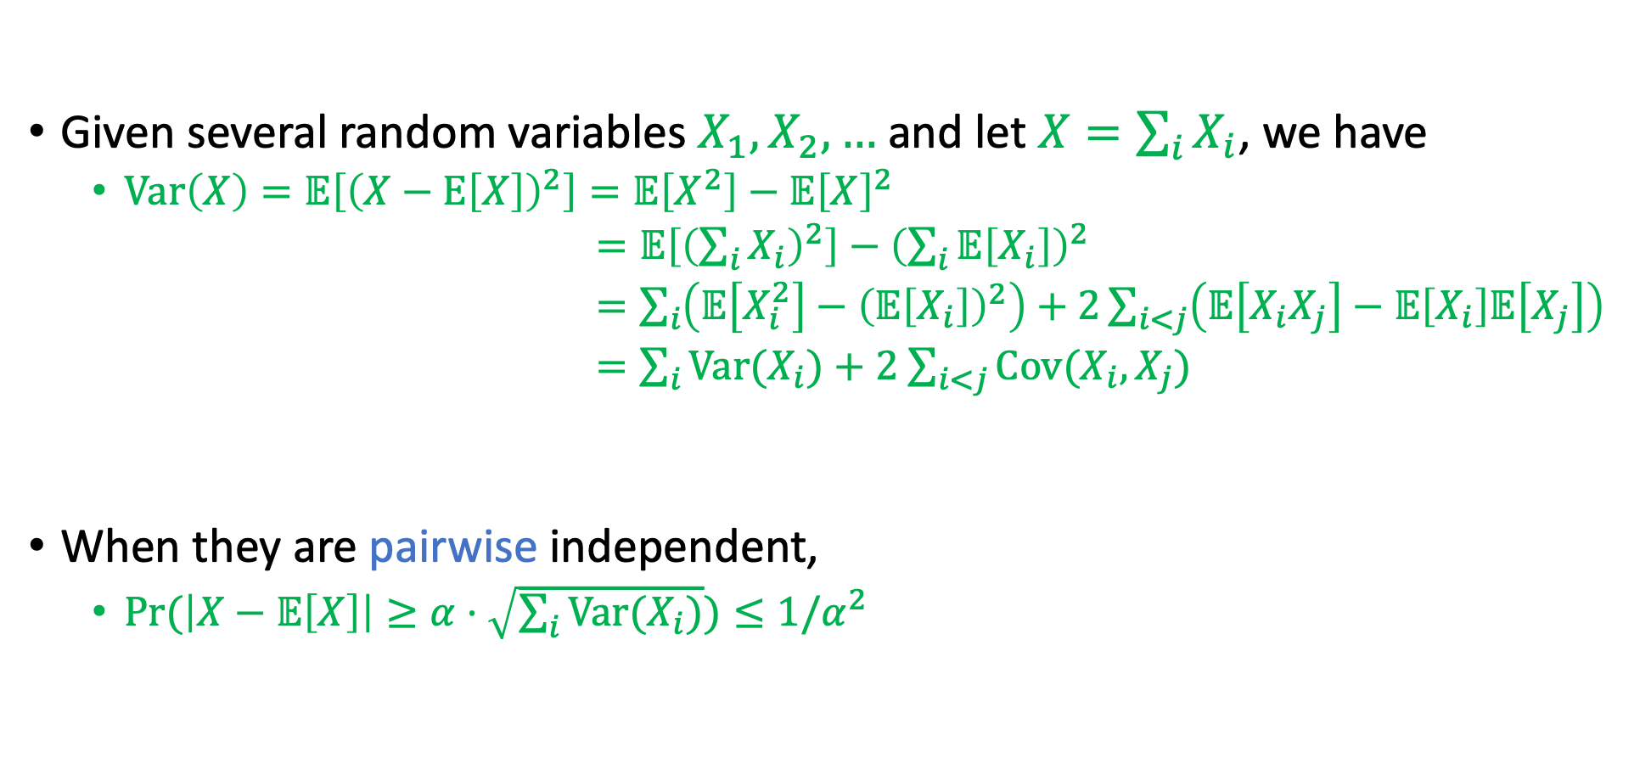
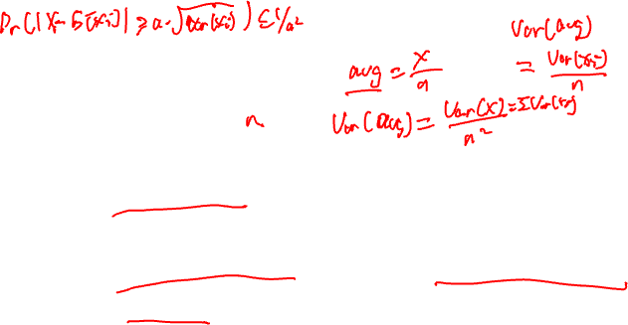
Chebyshev’s Inequality
Given several random variables $X_{1},X_{2},…$ and let $X=\sum_{i}{X_{i}}$, we have
$Var\left(X\right)=𝔼\left[{\left(X−Ε\left[X\right]\right)}^{2}\right]=𝔼\left[X^{2}\right]−𝔼{\left[X\right]}^{2}$
$=𝔼\left[{\left(\sum_{i}{X_{i}}\right)}^{2}\right]−{\left(\sum_{i}{𝔼\left[X_{i}\right]}\right)}^{2}$
$=\sum_{i}{\left(𝔼\left[X_{i}^{2}\right]−{\left(𝔼\left[X_{i}\right]\right)}^{2}\right)+2\sum_{i<j}{\left(𝔼\left[X_{i}X_{j}\right]−𝔼\left[X_{i}\right]𝔼\left[X_{j}\right]\right)}}$
$=\sum_{i}{Var(X_{i})}+2$ $\sum_{i<j}{Cov(X_{i},X_{j})}$
When they are pairwise independent,
$\operatorname{Pr}{(\left|X−𝔼\left[X\right]\right|≥α⋅\sqrt{\sum_{i}{Var(X_{i})}})}≤1/α^{2}$

Slide 38
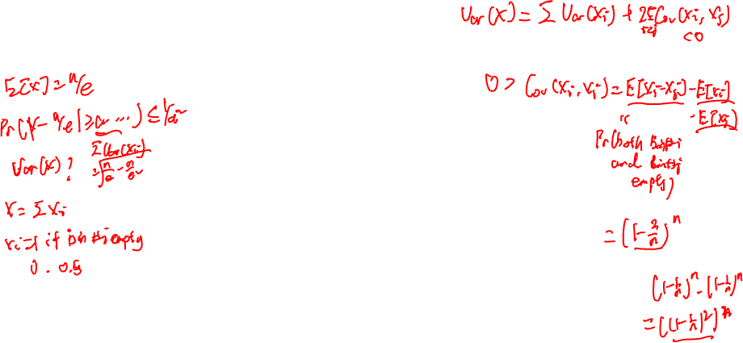
Exercise
n balls
Can we use Chebyshev’s Inequality to prove the concentration of the number of empty bins?
1
2
3
n

Slide 39
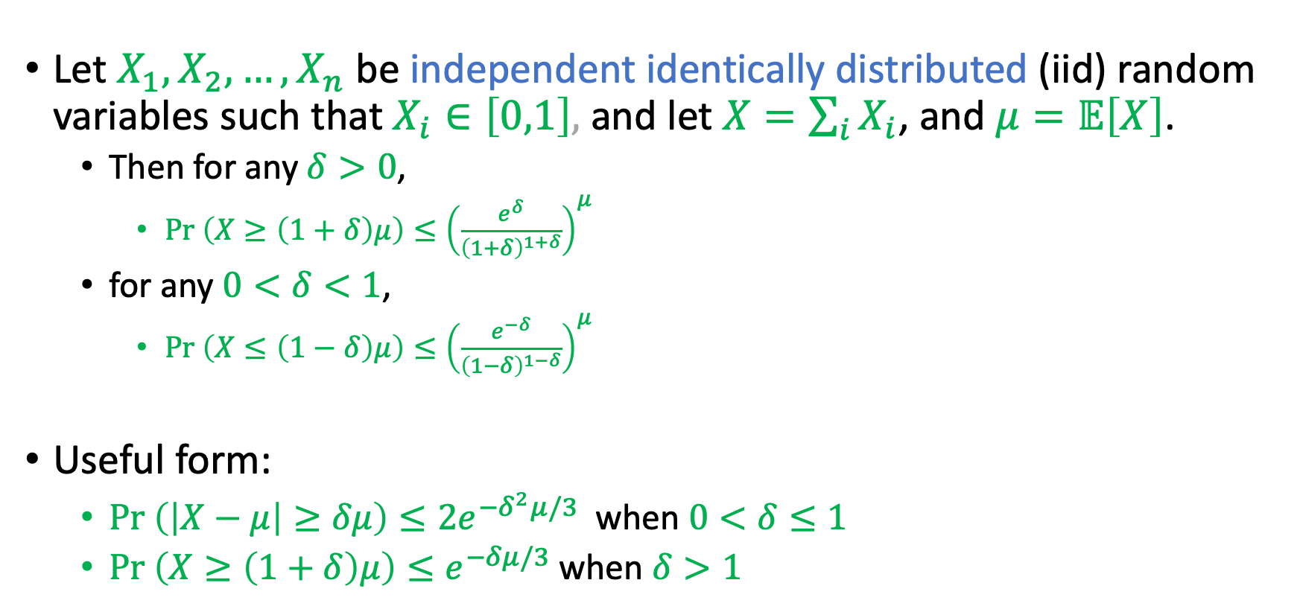
Chernoff Bound
Let $X_{1},X_{2},…,X_{n}$ be independent identically distributed (iid) random variables such that $X_{i}∈\left[0,1\right],$ and let $X=\sum_{i}{X_{i}}$, and $μ=𝔼\left[X\right]$.
Then for any $δ>0$,
$Pr \left(X≥\left(1+δ\right)μ\right)≤{\left(\frac{e^{δ}}{{\left(1+δ\right)}^{1+δ}}\right)}^{μ}$
for any $0<δ<1$,
$Pr \left(X≤\left(1−δ\right)μ\right)≤{\left(\frac{e^{−δ}}{{\left(1−δ\right)}^{1−δ}}\right)}^{μ}$
Useful form:
$Pr \left(\left|X−μ\right|≥δμ\right)≤2e^{−δ^{2}μ/3}$ when $0<δ≤1$
$Pr \left(X≥\left(1+δ\right)μ\right)≤e^{−δμ/3}$ when $δ>1$

Slide 40
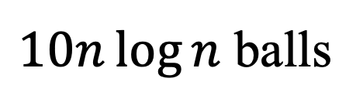

Exercise
$10n\log{n}$ balls
Use both Chebyshev’s Inequality and Chernoff’s Bound to prove the concentration of the number of balls in bin #2
1
2
3
n

Slide 41

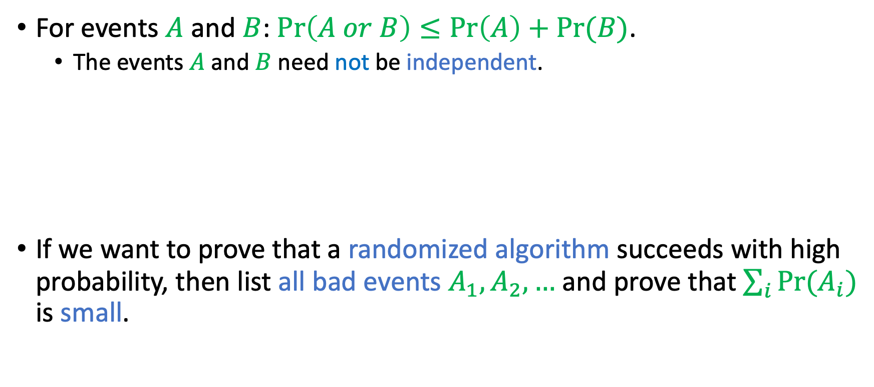

Union Bound
For events $A$ and $B$: $Pr\left(A or B\right)≤\operatorname{Pr}\left(A\right)+\operatorname{Pr}{(B)}$.
The events $A$ and $B$ need not be independent.
If we want to prove that a randomized algorithm succeeds with high probability, then list all bad events $A_{1},A_{2},…$ and prove that $\sum_{i}{\operatorname{Pr}{(A_{i})}}$ is small.
$$A$$
$$B$$

Slide 42

Exercise
Useful Inequality:
$${\left(1−\frac{1}{k}\right)}^{k}<\frac{1}{e}<{\left(1−\frac{1}{k}\right)}^{k−1}$$
In this course, we will just say
$${\left(1−\frac{1}{k}\right)}^{k}≈\frac{1}{e}$$
$10n\log{n}$ balls
Prove that the probability of having no empty bins is high.
1
2
3
n

